Slide 1

FluidsForLife.com
Connecting biologists with microfluidics / engineering, information, and networking tools
Information
Equipment
Networking
?
Guider Tour Button
Join our mailing list
Customer registration page
Custom designs
About us
Email info@flowcell.co
and maxn@flowcell.co
Link to “About us” section
or to the Blog
Notes:
Guided tour information:
FluidsForLife.com
From micro-physiological systems, to single-cell dispensers, to 3D cell printers we can connect you with technology and colleagues to enable your experiments
Buttons:
Information about various microfluidic systems for life sciences
Find specialized equipment for your needs
Network with biologists and engineers
Hyper-links at the bottom of the page could have explanations like this (left to right):
Customer registration page
Custom microfluidics designs, and consulting
Read about our story, and mission

Slide 2
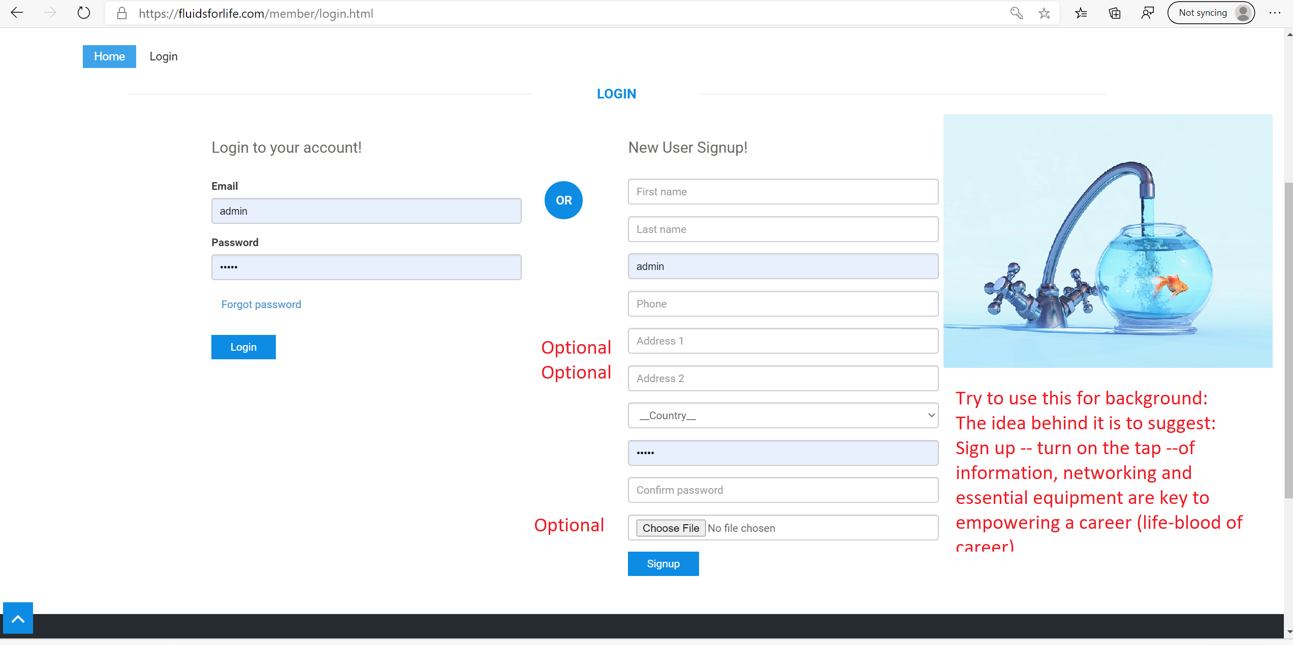

Slide 3
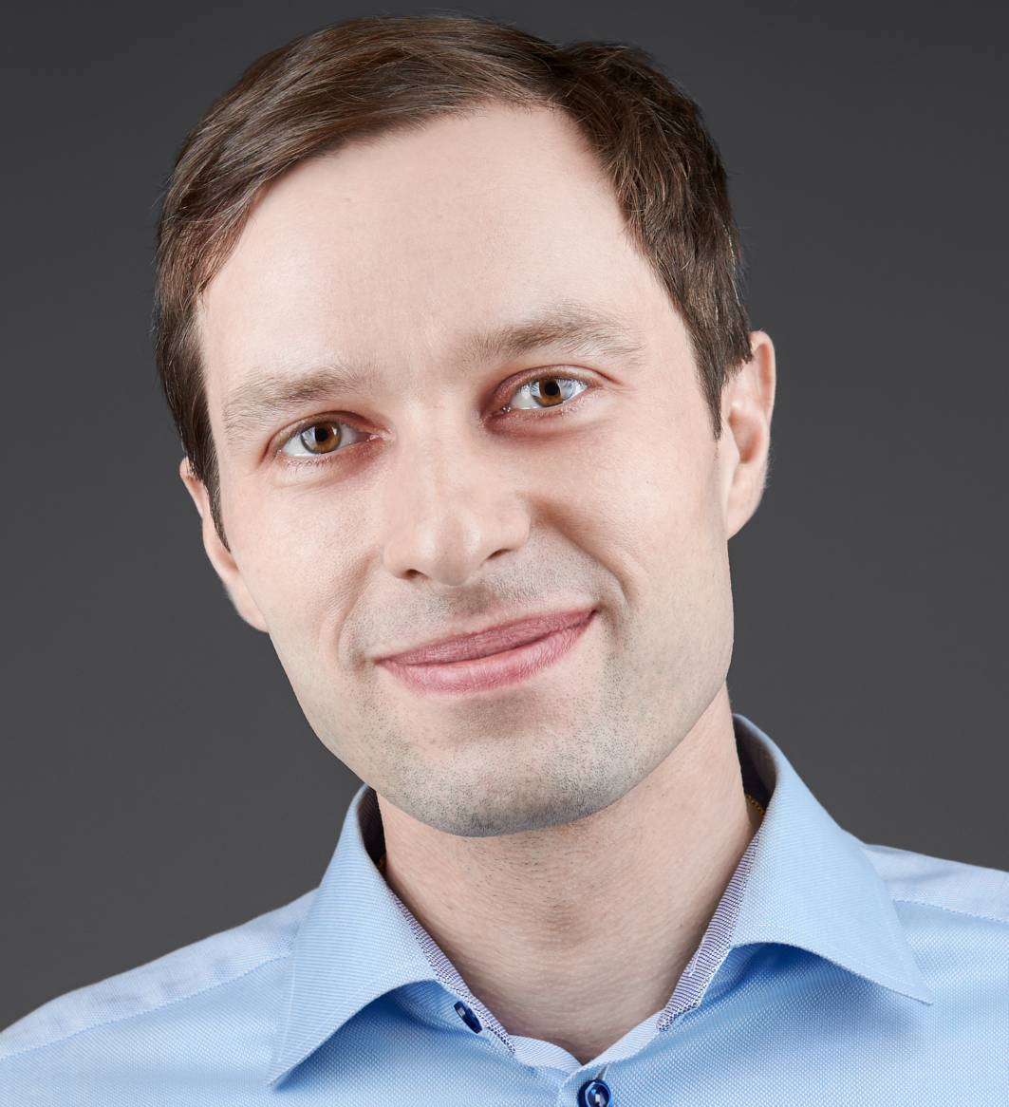
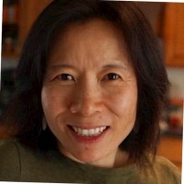

Networking on PC & on Mobile
Max Narovlyansky, PhD
Jean Zhang, PhD
Skills:
Microfluidics
Drug discovery
Bio-chemistry
Multi-physics modeling
Sensors & analytics
Needs:
Partners for NIH grant for use of MPS for COVID19
Organoid specialists
Fundraising
Skills:
Drug discovery
Cancer biology
Organoid culture
Chemical library screening
Needs:
Leadership opportunities in biotech
Technology specialists
Flexible partnership
Expert in microfluidics
Experienced in drug discovery and companion diagnostics
maxn@flowcell.co
1.617.755.9778
Expert in discovery & organoids technology
Jeanzhang105@gmail.com
1.978.621.1157

